Slide 1


وزارة التعليم العالي والبحث العلمي
جامعة البصرة
كلية الطب البيطري
المحاضرة الافتتاحية التعريفية
للعام 2025-2026
الأستاذ الدكتورة سوزان عبد الجبار عبد العزيز اللمعلمان
مقرر ومسؤول مادة الطفيليات البيطرية

Slide 2
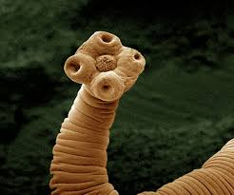

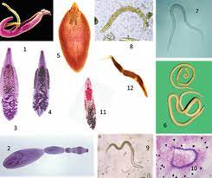
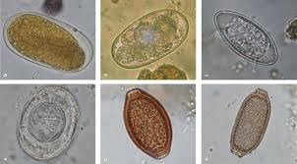

Slide 3

NAME OF SUBJECT VETERINARY PARASITOLOGY
COLLEGE OF VETERINARY MEDICINE
UNIVERSITY OF BASRAH
THIRD CLASS
TWO SEMESTARS

Slide 4
FIRST SEMESTARS INCLUDES
INTRODUCTION:
1- Introduction and definitions of terms
2- Types of living, transmission, life cycle, immunology
PHYLUM PLATYHELMINTHES:
Phylum: Platyhelminthes this is divided into:
Class: Trematoda includes families below:
- Fasciolidae, Dicrocoelidae, Paramaphistomatidae, Schistosomatidae,
Troglotrematidae, Echinostomatidae, Heterophyidae, Opisthorichidae.
Class: Cestoda includes families below:
- Taeniidae, Anoplocephaliadae, Thysanoidae, Divaineidae, Dipylidiidae, Hymenolepididae, Mesocestodiae, Diphyllobothriidae.

Slide 5
PHYLUM NEMATOHELMINTHE:
Phylum: Nematoda includes families below:
-Ascaridae Scarodidae, Hetrakidae, Subbuluridae, Oxyuridae, Rhabditidae, Strongyloidae, Trichonematidae, Ancylostomatidae, Trichostrongylidae, Dictyocaudlidae, Metastrongyloidae, Trichuridae, Trichinellidae, Spriuroidae, Fillariidae.

Slide 6
LECTURER AT FIRST SEMESTAR
PROF. DR. SUZAN A. A. AL-AZIZZ AND PROF. DR. ALAA TARIQ
INTRODUCTION AND TREMATODA
PROF. DR. GHAZI Y. A. ALEMARAH AND LCTE. DR. ALAA I. SOUD
NEMATOHEMINTHES
PROF. DR. MUNA M. JORI AND PROF. DR. ALAA TARIQ
CESTODA

Slide 7
SECOND SEMESTARE INCLUDE
PROTOZOA
Phylum: Protozoa includes families below:
Trypanosomatidae, Trichomonadae, Monocercomonadidae, Eimeriidae, Sarcocystidae, Cryptoseoridiidae, Plasmodiidae, Babesiidae, Theileriidae.
ARTHROPODA
Phylum: Arthropoda includes families below:
Ixodidae, Argasidae, Sarcoptidae, Psorptidae, Tabanidae, Culicidae, Psychodidae, Simuliidae, Osteridae, Calliphoridae, Anthromyidae, Cimicidae, Haematopinidae, Linognathidae, Ischnocera, Amblycera.

Slide 8
STAY STRONG… ONE DAY YOU WILL BE ABLE TO LOOK BACK AND SAY I MADE IT. BUT NO SPOON FEEDING. DO IT BY YOUR HANDS ONLY

Slide 9
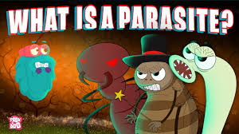
WHY WE ARE STUDING PARASITOLOGY???????????????????
Every animal and human is susceptible for any parasite infections

Slide 10
THIS QUESTION VERY HARD? PARASITES MAY BE IN YOUR LIVER, LUNG, INTESTINE.. OHH MY GOD, IS THIS A JOK OR WHAT?

Slide 11
SO, BECAUSE OF THIS AND THIS AND THIS

Slide 12
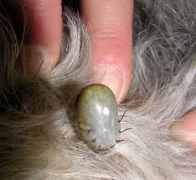
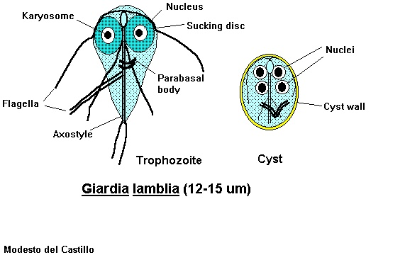
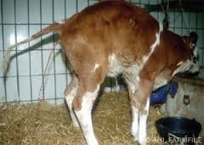
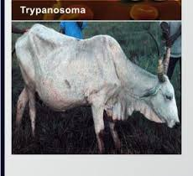

Slide 13
IMPORTANT WEB SITE Google Scholar https://scholar.google.com/citations?user=2PIFs-IAAAAJ&hl=en Research Gate https://www.researchgate.net/profile/Suzan_Al-Azizz/stats/recommendations?ref_hfsw=1 Academia https://uobasrah.academia.edu/suzanalaziz

Slide 14

GIVE ME YOUR HAND AND GO ON
THANK YOU

